Slide 1

Book Recommendation Chatbot Using IBM Watson Assistant
(AI-Powered )
Presented by Aditya Sharma for the AI-PBEL Internship

Slide 2



INTERNSHIP CONTEXT
AI-PBEL Internship Objectives
Participated in the AI-PBEL (Project-Based Experiential Learning) internship, focused on solving real-world problems using Artificial Intelligence. Developed an AI-powered conversational assistant for personalized book recommendations using IBM Watson Assistant. The project leveraged Natural Language Processing (NLP) and intent recognition to understand user preferences (genre, author). Gained hands-on experience in building practical AI solutions with real-time chatbot interfaces.
Practical AI Application
Experiential Learning
Problem Solving
Applying theoretical AI knowledge to a tangible project.
Gaining hands-on experience in chatbot development.
Addressing a common user challenge with an intelligent solution.

Slide 3
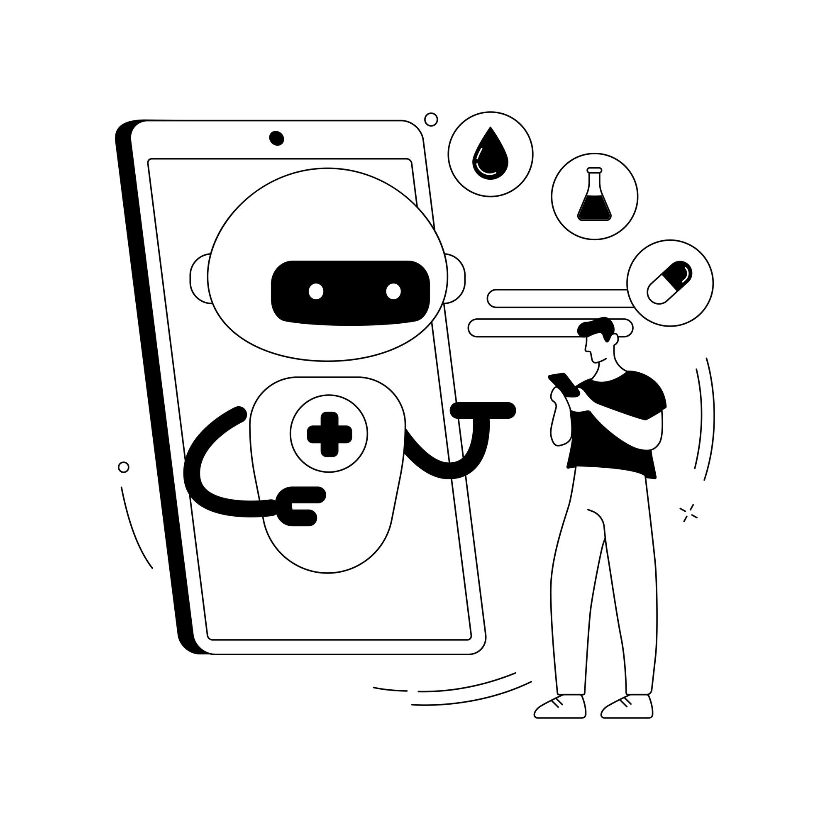
PROJECT OVERVIEW
Book Recommendation Chatbot
This project introduces an AI-powered chatbot designed to streamline the process of discovering books. Leveraging IBM Watson Assistant, the chatbot provides intelligent recommendations based on user-specified genres and authors, transforming the traditionally time-consuming book search into an intuitive conversational experience. The goal is to simplify book discovery through intelligent conversation.

Slide 4


THE CHALLENGE
Problem Statement & Objectives
Problem: Information Overload
Objective: Personalised Discovery
Users often face difficulty finding books aligned with their specific interests amidst a vast sea of choices. Generic search engines and manual browsing platforms lack the personalization needed for an efficient discovery process, leading to frustration and wasted time.
To address this, the project aims to:
Develop a chatbot that intuitively understands user preferences.
Provide relevant and personalised book recommendations conversationally.
Enhance user experience through an intelligent and interactive interface.

Slide 5
AI AT ITS CORE
AI/ML Techniques Used
The chatbot’s intelligence is powered by several key AI/ML techniques, primarily facilitated by IBM Watson Assistant. These techniques enable the chatbot to understand user queries, maintain context, and provide relevant responses effectively.
Natural Language Processing (NLP)
1
Utilised for understanding and interpreting user inputs, allowing the chatbot to process genre and author preferences expressed in natural language.
Intent Recognition
2
Enables the chatbot to identify the user's underlying goal (e.g., 'recommend_book', 'greet') from their conversational utterances.
Entity Extraction
3
Allows the chatbot to pinpoint specific pieces of information within user inputs, such as book genres (e.g., 'Science Fiction', 'Fantasy') or author names (e.g., 'Isaac Asimov', 'Jane Austen').
Rule-Based Logic
4
Employed for decision-making within the dialog flow, triggering specific book recommendations based on recognised intents and extracted entities.
Fallback Handling
5
Ensures a smooth conversational experience by providing appropriate responses when user inputs are vague, incomplete, or outside the chatbot's defined scope.

Slide 6





TECHNICAL FOUNDATION
Tools & Architecture
The chatbot’s functionality relies on a streamlined architecture and a focused set of tools, with IBM Watson Assistant forming the core of its intelligence and conversational capabilities.
Key Tools
System Architecture
IBM Watson Assistant: The primary AI engine for NLP, intent recognition, entity extraction, and dialog management.
Dataset: A static JSON-based book catalogue categorised by genre and author. (Optional: Integration with Google Books API for dynamic content).
UI: IBM Watson Assistant's native chat interface, or potentially embedded within a custom web/chat application.
NLP Processing
Response Sent
User Input
Dialog Logic
User Interaction: Input is received via a chatbot interface. NLP Processing: IBM Watson Assistant performs intent and entity detection. Dialog Logic: Based on detected intents and entities, the chatbot's dialog logic triggers the recommendation process. Data Retrieval: Book recommendations are fetched from the dataset (static JSON or API). Response: The final book recommendation is delivered back to the user.

Slide 7
CHATBOT CAPABILITIES
Key Features & Design
The chatbot is designed for intuitive interaction, providing targeted recommendations and robust error handling. Its core features ensure a seamless user experience while leveraging Watson's capabilities for intelligent conversation.
Core Features
IBM Watson Design
Understands User Input
Intents
Accurately interprets user requests for genres and authors.
Defined user goals: recommend_book, greet, goodbye.
Provides Recommendations
Entities
Responds with relevant book titles and descriptions.
Specific data points: genre (e.g., Science Fiction), author (e.g., Jane Austen).
Handles Unknown Inputs
Dialog Tree
Manages unrecognised queries with informative fallback replies.
Conversational flow: Greet → Ask Genre → Ask Author → Recommend Book.
Expandable Content
Easily scalable by adding more books, genres, or authors.
Error Handling
Built-in fallbacks and error messages for robust interactions.

Slide 8
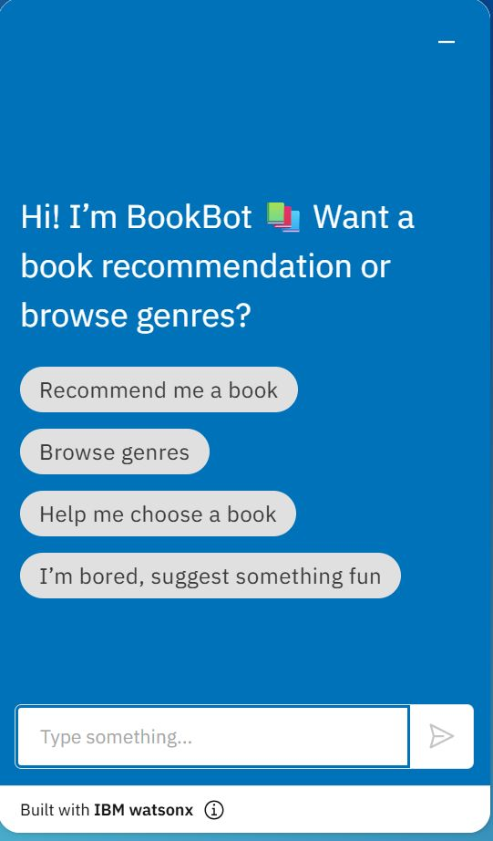
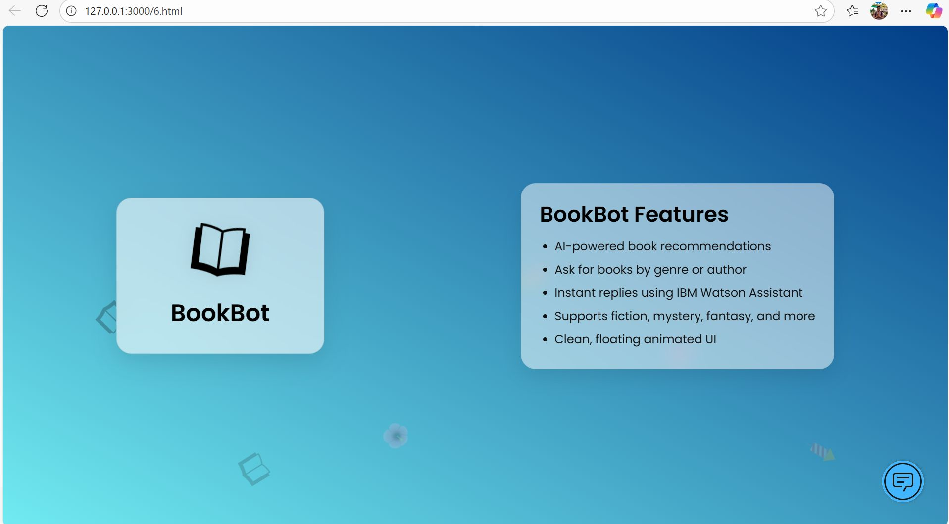
VISUAL EVIDENCE
Implementation Snapshots
These screenshots provide a glimpse into the chatbot's development environment and its live interaction. They showcase the configuration within IBM Watson Assistant and a typical conversation flow.

Slide 9
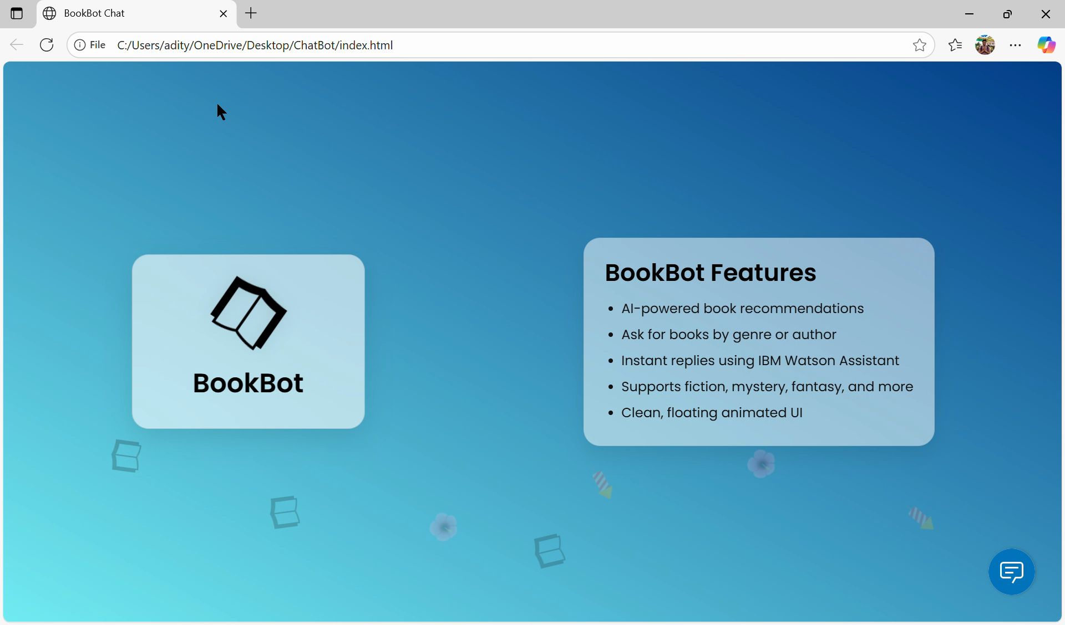

Slide 10
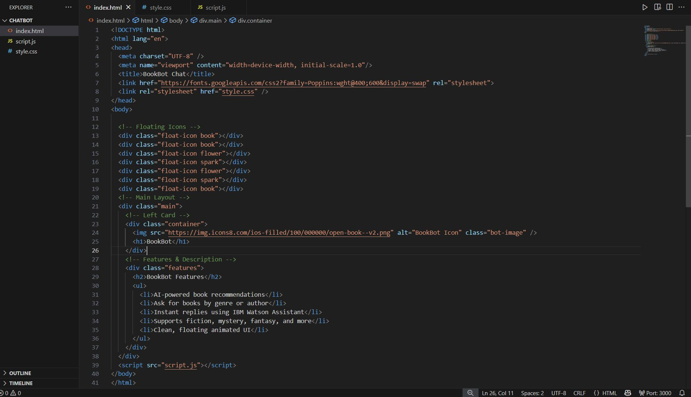
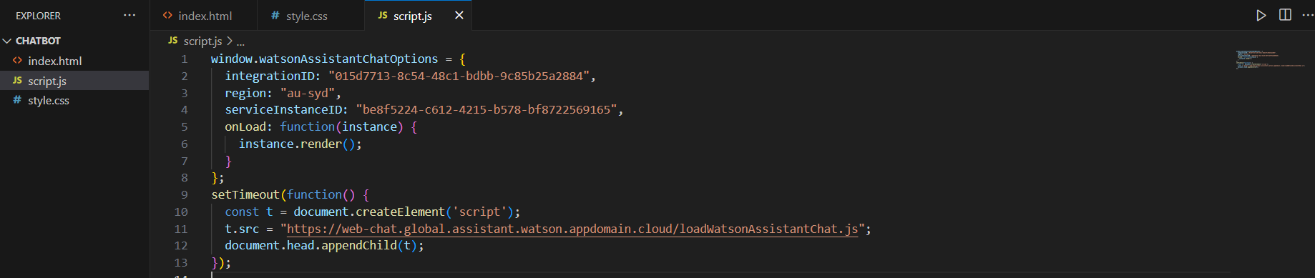

Slide 11
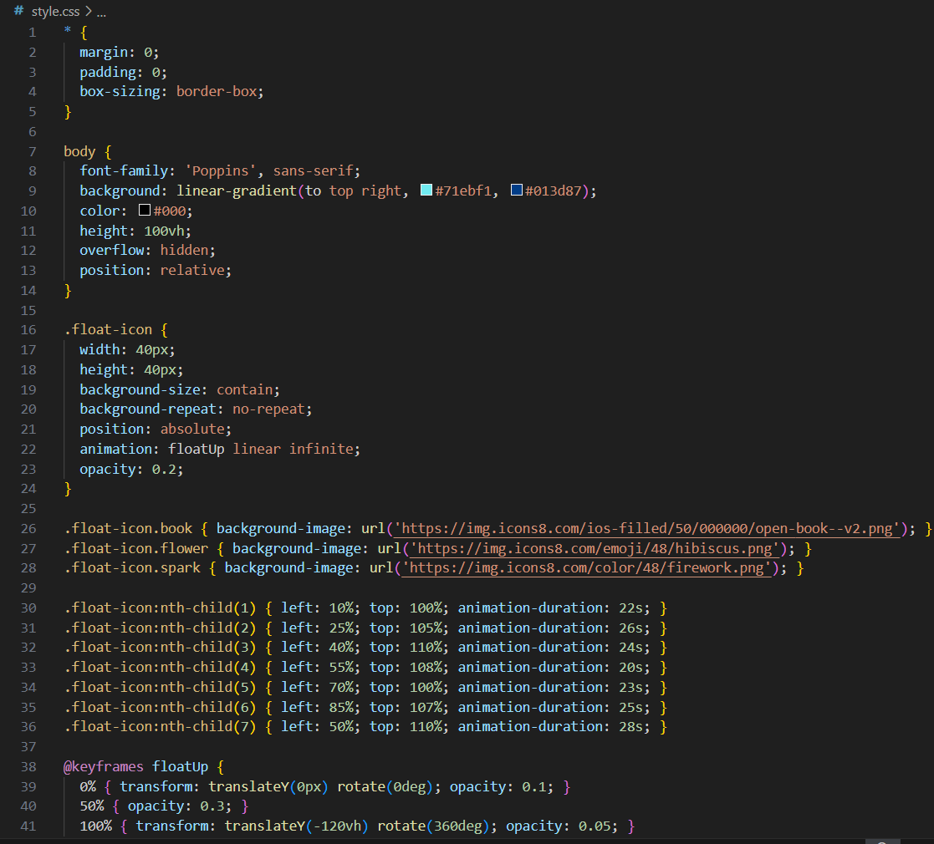
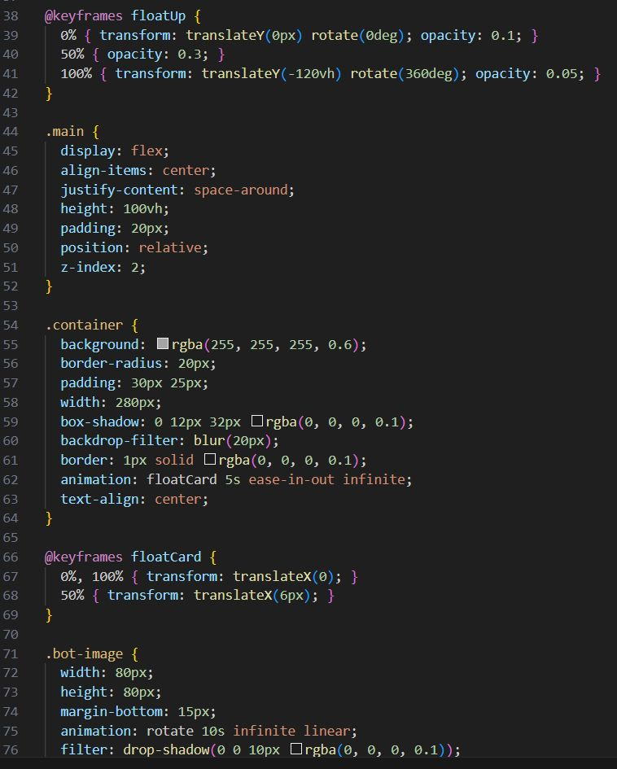

Slide 12
INSIGHTS GAINED
Challenges & Learnings
Developing the chatbot presented several challenges, particularly in fine-tuning conversational logic and data management. These obstacles, however, provided valuable learning experiences in practical NLP and chatbot development.
Watson Configuration
Dialog Flow Design
Navigating and optimising IBM Watson's intent, entity, and dialog configuration was crucial. This involved iterative testing to achieve accurate recognition and smooth transitions.
Crafting meaningful and natural conversation flows proved challenging, especially when handling multiple inputs and potential ambiguities. Balancing directed questions with open-ended responses was key.
Book Suggestions
Input Variability
Ensuring the recommended books were relevant and diverse required careful curation of the dataset. This highlighted the importance of well-structured data for effective recommendations.
Handling vague or incomplete user inputs required robust fallback mechanisms and extensive training of the NLU model to maintain a seamless conversational experience.
Key Takeaway: This project provided practical exposure to conversational AI and the iterative nature of chatbot development, from initial design to fine-tuning user interactions.

Slide 13
PROJECT SUMMARY
Conclusion & Future Scope
The project successfully delivered a functional book recommendation chatbot, demonstrating the practical application of AI in enhancing user experience for book discovery.
Project Summary
Future Enhancements
We successfully developed an AI-powered book recommendation chatbot using IBM Watson Assistant. This solution effectively addresses the problem of manual book discovery by providing personalised, conversational recommendations based on genre and author preferences. It showcases the power of NLP, intent recognition, and dialog management in creating intelligent conversational interfaces.
1
Live API Integration
Connect to live book APIs (e.g., Google Books, Goodreads) for dynamic and up-to-date recommendations.
2
Voice Support
Integrate voice input capabilities for a hands-free conversational experience.
3
ML-based Recommendations
Implement advanced machine learning models for more personalised recommendations based on user history and implicit feedback.
4
UI Integration
Embed the chatbot into a dedicated website or mobile application for wider accessibility and a richer user interface.

